Slide 1
Types of Dimensions

Slide 2
1. Conformed Dimension
A conformed dimension is a dimension that has the same meaning to every fact with which it relates.
It can be used across many fact tables in different subject areas of the warehouse.
Date is a common conformed dimension because its attributes (day, week, month, quarter, year, etc.) have the same meaning when joined to any fact table.

Slide 3
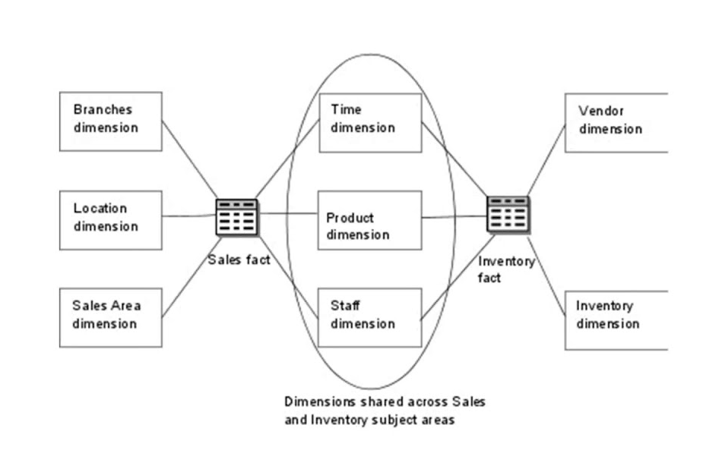
Example of Conformed Dimension

Slide 4
2. Junk Dimensions
A junk dimension is a convenient grouping of typically low-cardinality flags and indicators.
By creating an abstract dimension, these flags and indicators are removed from the fact table while placing them into a useful dimensional framework
A Junk Dimension is a dimension table consisting of attributes that do not belong in the fact table or in any of the existing dimension tables.
Example → Assume that we have a gender dimension and marital status dimension. In the fact table we need to maintain two keys referring to these dimensions. Instead of that create a junk dimension which has all the combinations of gender and marital status (cross join gender and marital status table and create a junk table). Now we can maintain only one key in the fact table.

Slide 5
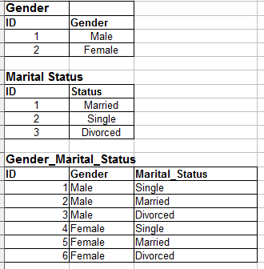
Example of Junk Dimension

Slide 6
3. Degenerate Dimensions
A degenerate dimension is a key, such as a transaction number, invoice number, ticket number, or bill-of-lading number, record number, etc. that has no attributes and hence does not join to an actual dimension table.
Degenerate dimensions are very common when the grain of a fact table represents a single transaction item or line item because the degenerate dimension represents the unique identifier of the parent.
Degenerate dimensions often play an integral role in the fact table's primary key.

Slide 7
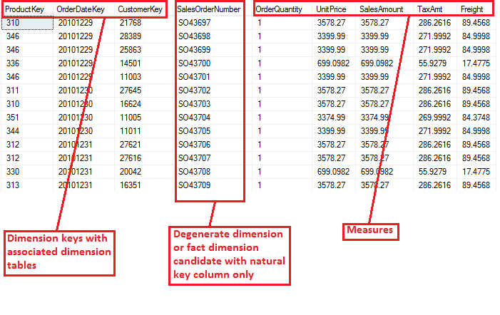
Example of Degenerate Dimension
See this Fact Table

Slide 8
4. Role Playing Dimension
Dimensions which are often used for multiple purposes within the same database are called role-playing dimensions.
This is most commonly seen in dimensions such as Time and Transactions, where in from Time dimension there is Date as PK and the same Date will act as FK in multiple columns of the transactions table such as OrderDate, ShipDate and DueDate.
So, in the above example Date of Time Dimension can be called as Role Playing Dimension, as it is playing different roles as Order Date, ship date as well as due date.

Slide 9
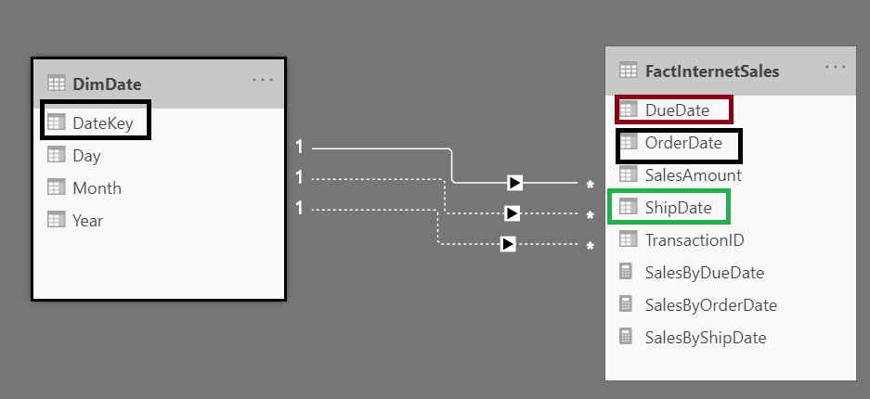
Example of Role Playing Dimension

Slide 10
5. Static Dimensions
Static dimensions are not extracted from the original data source
Actually they are created within the context of the data warehouse.
Example: Generating the Date or Time Dimension in Data Warehouse which will have a record for every date, and then other date columns such as year, quarter, month are derived from it.
Further, the Date or Time Dimension is joined with the Business or Fact table!

Slide 11
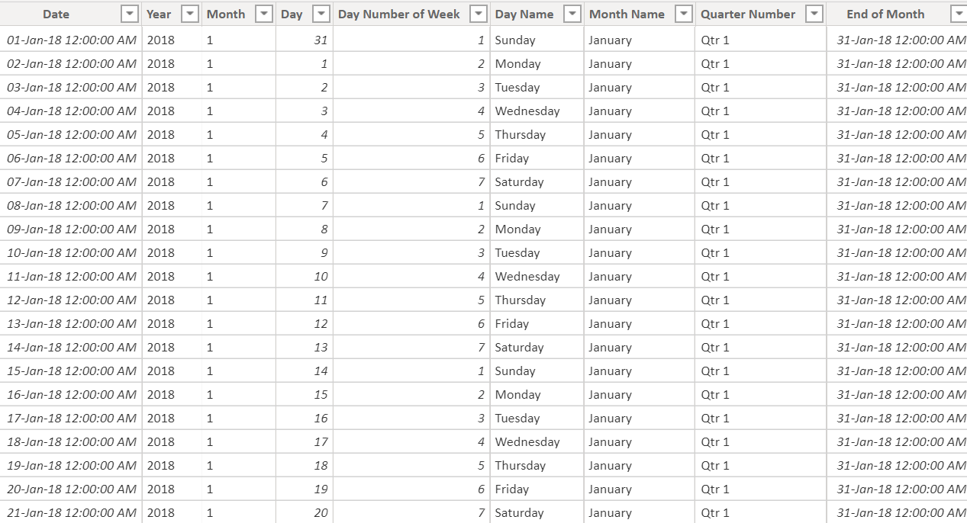
Example of Static Dimension – Part 1

Slide 12
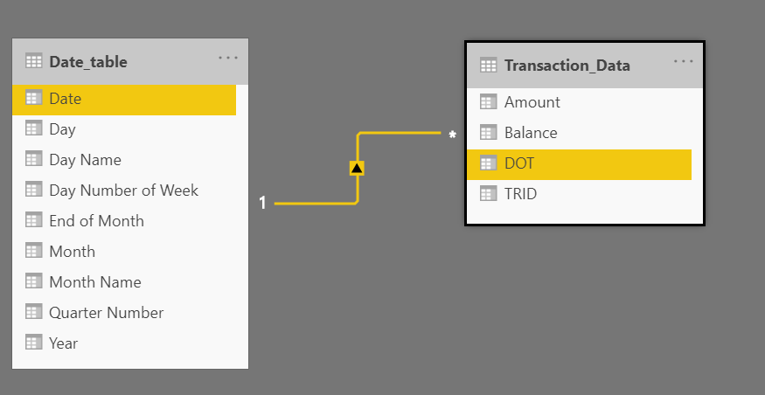
Example of Static Dimension – Part 2

Slide 13
6. Inferred Dimensions
Inferred Dimension, also referred to as:
Early coming Fact
OR
Late coming dimension.
These all are different names of same scenario.
Ideally, if the source systems of your Data warehouse are very well designed, you should never face this scenario.
But, sometimes it would happen that the fact data is available in the source but related dimension data does not yet exists.

Slide 14
Example of Inferred Dimension – Part 1
Consider that Online Movie Ticketing business scenario. Suppose a sales person sold some bulk movie tickets to an organization at some discount. He provided a discount with a new promotion code, which he is supposed to punch in the system, but he forgot. When the ETL would process the data it will find that the promo code is not available.
There are 2 ways to handle this scenario:
1st one is to mark the FKey as unknown. This is the simplest option but these sales records could not be used for the reporting purpose unless the dimension record arises or the fact is updated accordingly. Which is an ETL overhead altogether.
The other option is to use Inferred Dimension. For any such record we could create an entry in the dimension table and mark it inferred.

Slide 15
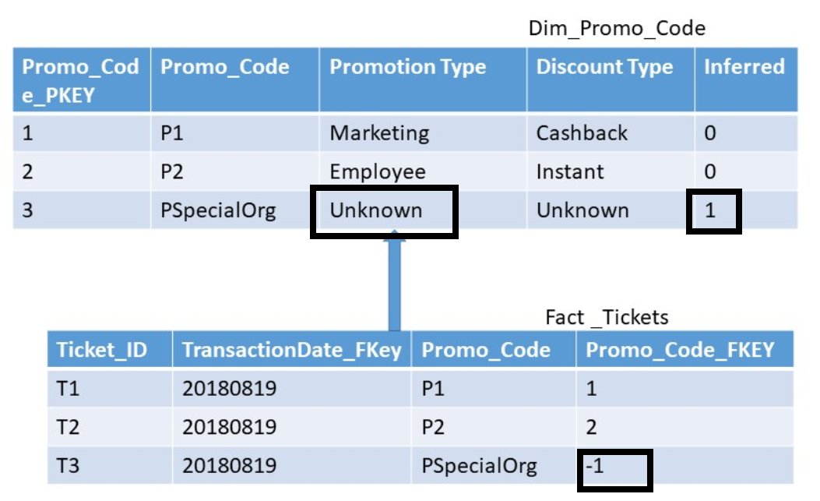
Example of Inferred Dimension – Part 2

Slide 16
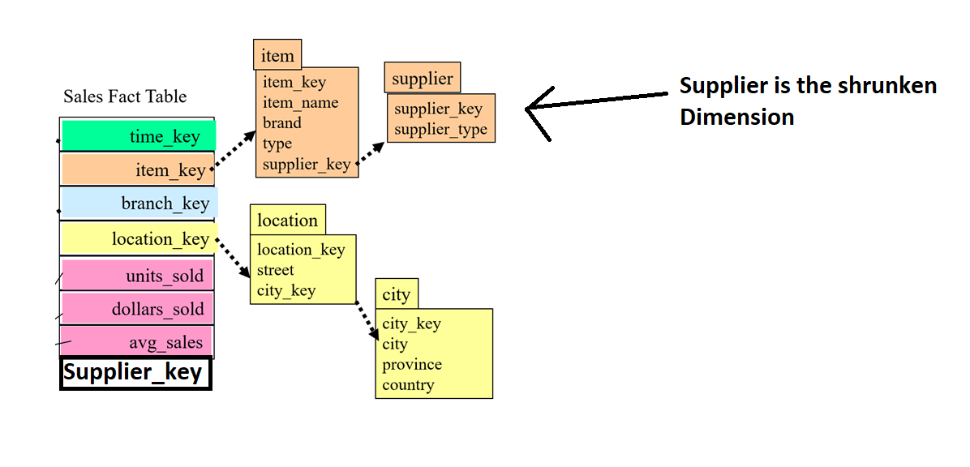
7. Shrunken Dimension
A shrunken dimension is a subset of another dimension.
Consider the following scenario:
There are 3 tables, Sales is the fact table, Item is the main dimension table and Supplier is other dimension table.
Supplier dimension is the subset of Items dimension table.
If Supplier_key is also FK in the Sales Fact table then we can say Supplier is a Shrunken Dimension
Shrunken Dimension is applicable in Snowflake Schema.

